Slide 1
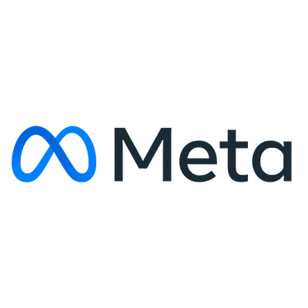


Meta
NewtonSchool
Instagram Engagement Analytics
Understanding user behaviour to improve marketing decisions
-CharuTrishoola Mohan Udaiyar
SOCIAL MEDIA | INSTAGRAM
JANUARY 2026

Slide 2
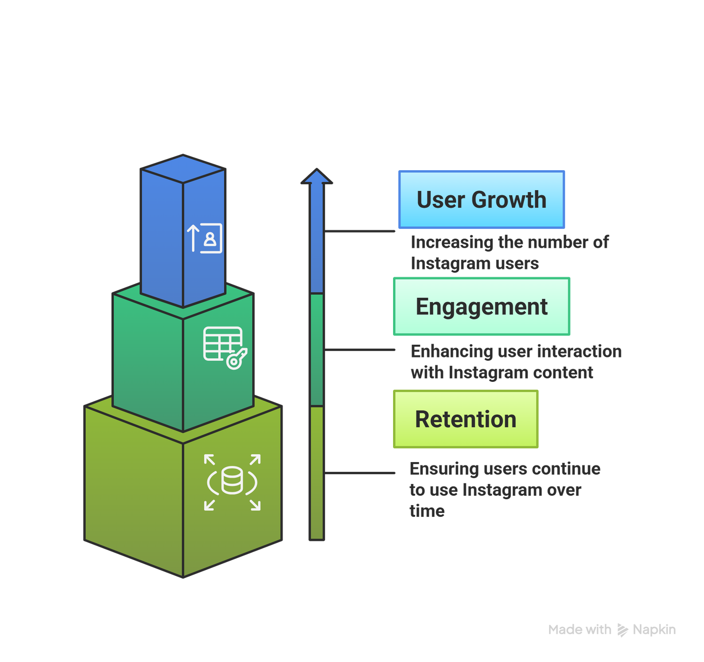
Meta
NewtonSchool
Problem Statement
As a data analyst at Meta supporting the marketing team, my goal is to use Instagram’s user data to improve Engagement, Retention, and User growth.
SOCIAL MEDIA | INSTAGRAM
PAGE|2

Slide 3

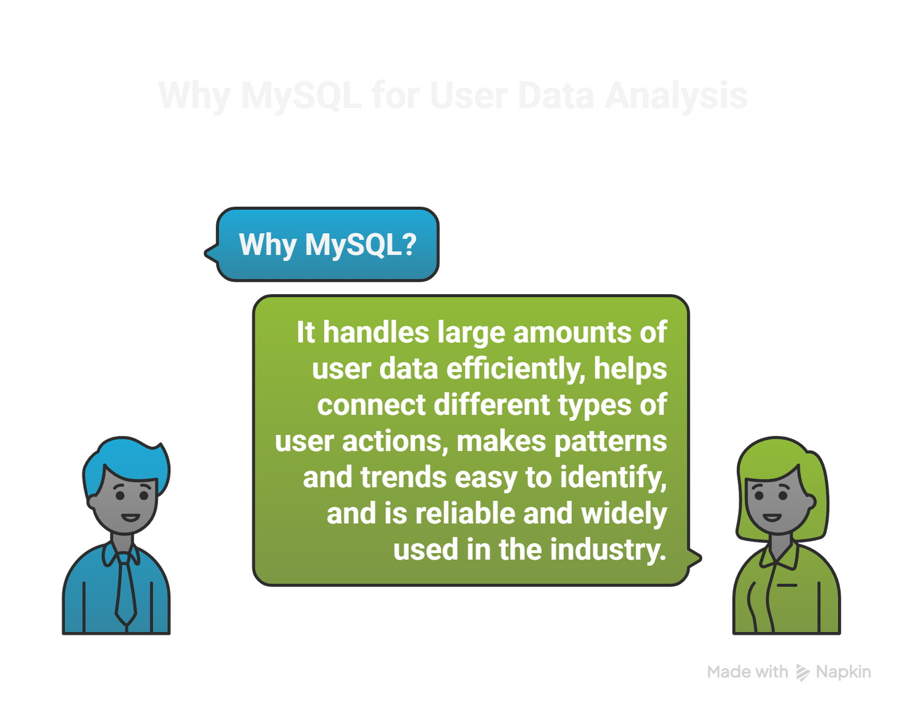
Meta
NewtonSchool
Why MySQL?
Handles large amounts of user data efficiently
Helps connect different types of user actions
Makes patterns and trends easy to identify
Reliable and widely used in the industry
SOCIAL MEDIA | INSTAGRAM
PAGE|3

Slide 4
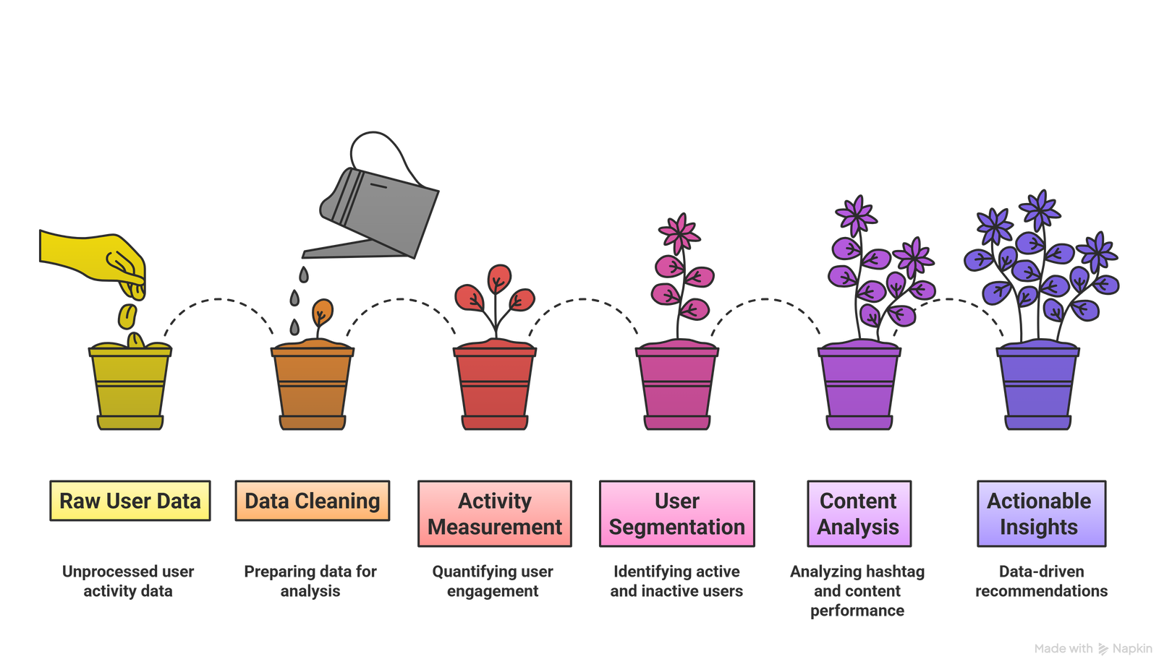
Meta
NewtonSchool
How I used It?
Handles large amounts of user data efficiently
Helps connect different types of user actions
Makes patterns and trends easy to identify
Reliable and widely used in the industry
SOCIAL MEDIA | INSTAGRAM
PAGE|5

Slide 5
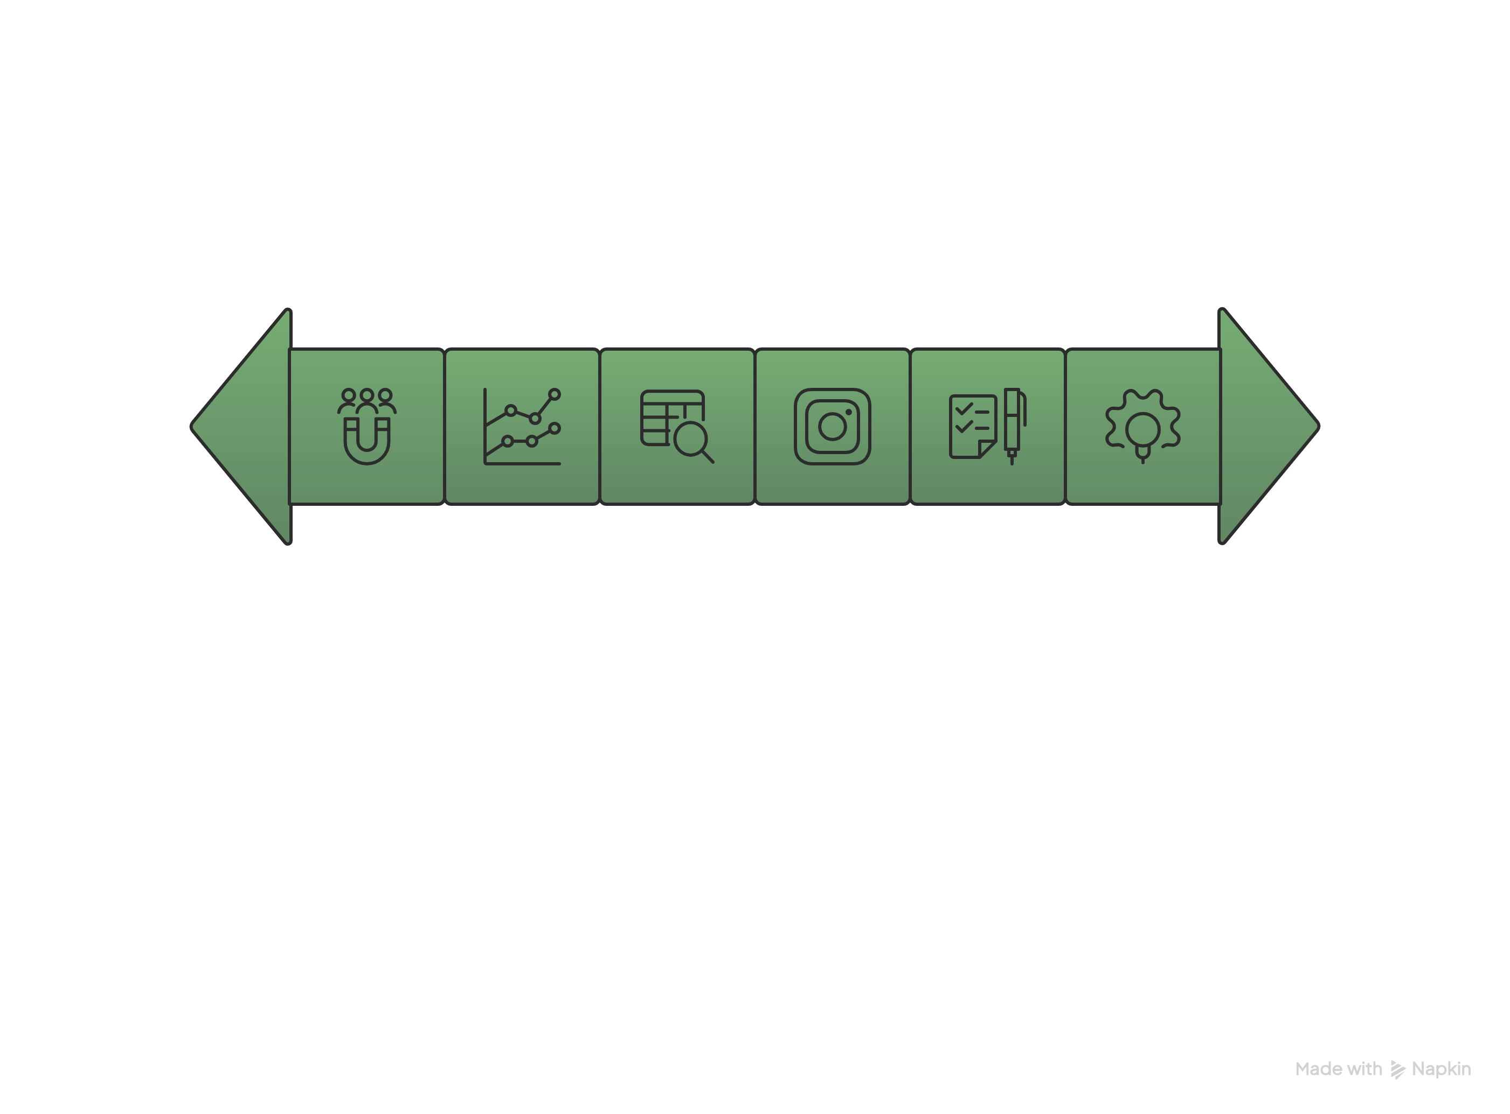
Meta
NewtonSchool
Agenda
What Data We Looked At
What This Means for Instagram
Recommendations
Why Engagement Matters
What We Observed
Takeaways
SOCIAL MEDIA | INSTAGRAM
PAGE|5

Slide 6
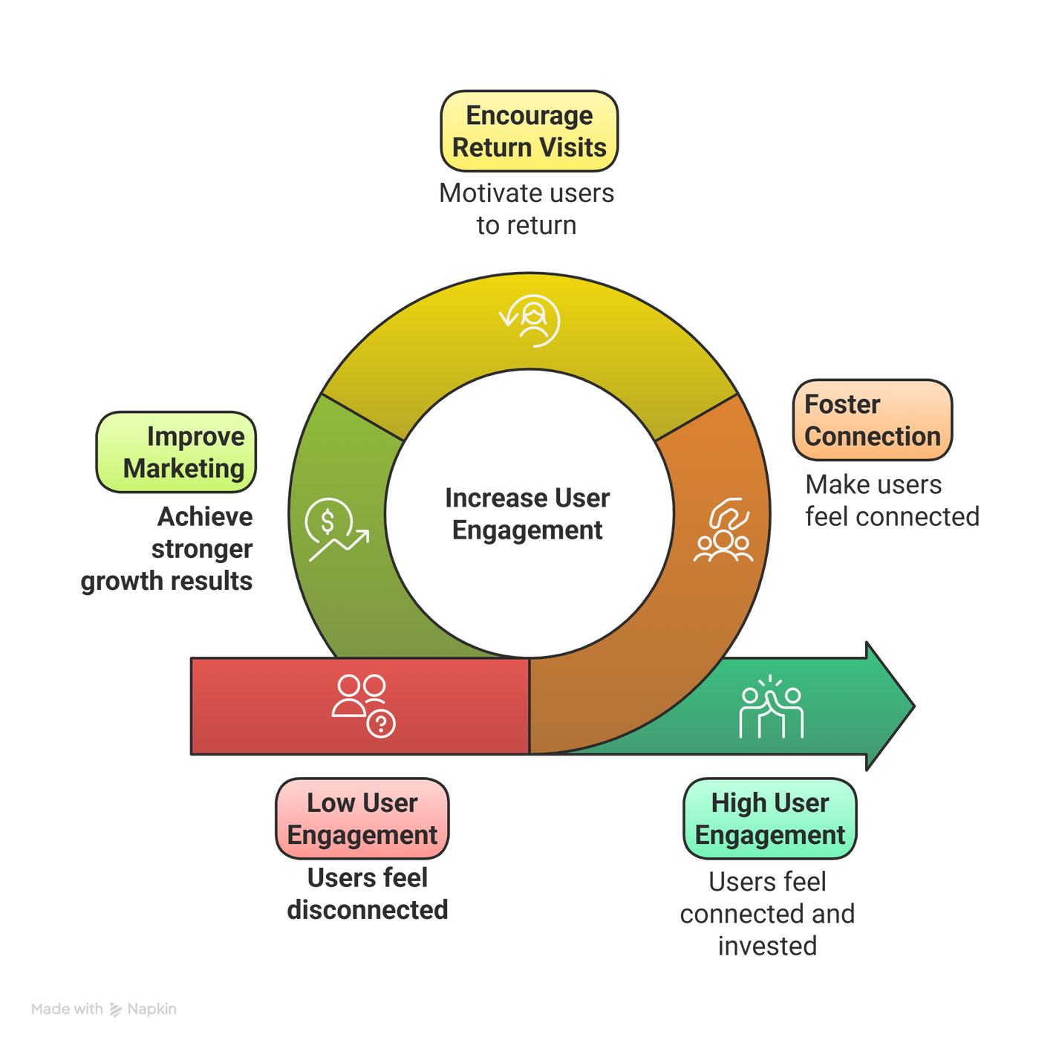
Meta
NewtonSchool
Why Engagement Matters?
Engagement shows how connected users feel to the platform
Engaged users stay longer and return more often
Higher engagement leads to stronger growth and better marketing results
SOCIAL MEDIA | INSTAGRAM
PAGE|6

Slide 7
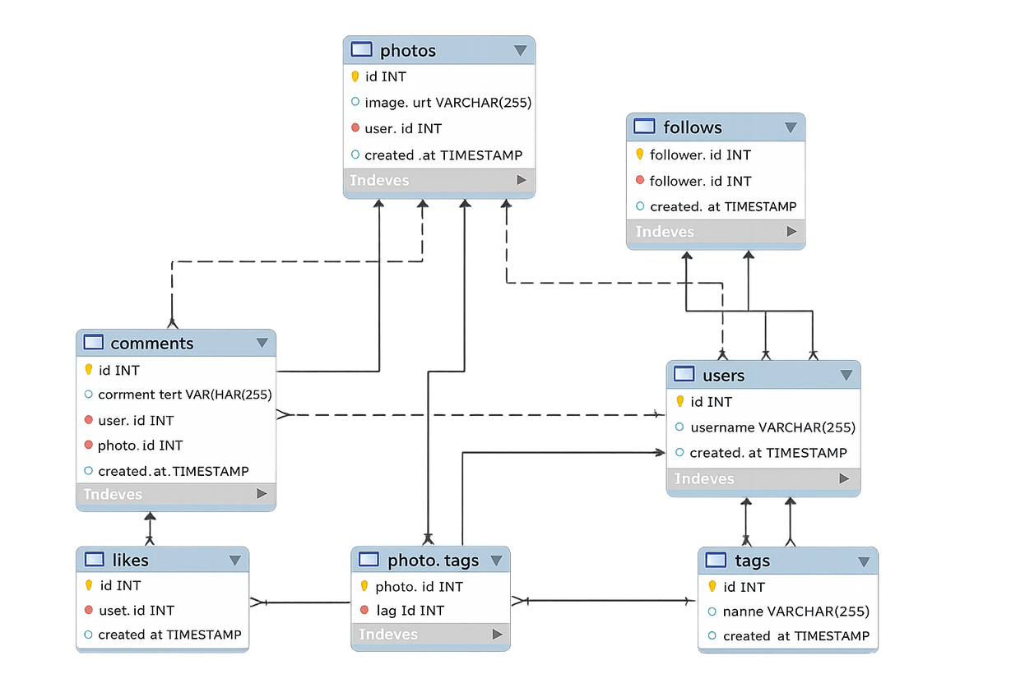
Meta
NewtonSchool
What Data We Looked At? (Data Schema)
This data helps us understand how users interact on Instagram.
User profiles and basic account details
Posts shared by users
Likes and comments on posts
Followers and following relationships
Hashtags used in posts
SOCIAL MEDIA | INSTAGRAM
PAGE|7

Slide 8

What We Observed ?
SOCIAL MEDIA | INSTAGRAM
JANUARY 2026

Slide 9
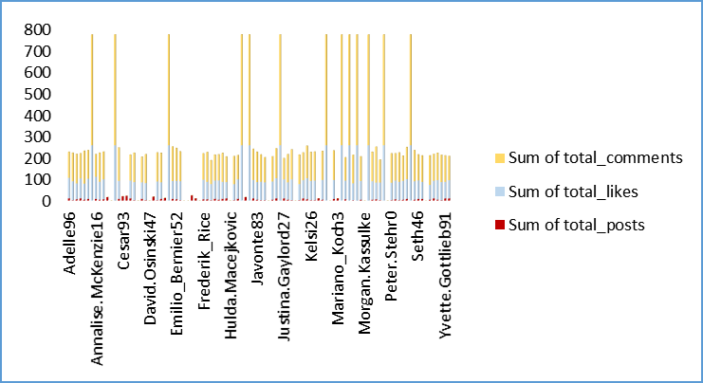
Meta
NewtonSchool
Engagement Is Not Equal Across Users
A small group of users creates most activity
Many users interact very little
Engagement depends on a few active users
*
This shows a clear imbalance where platform engagement depends on a limited set of active users.
SOCIAL MEDIA | INSTAGRAM
PAGE|9

Slide 10
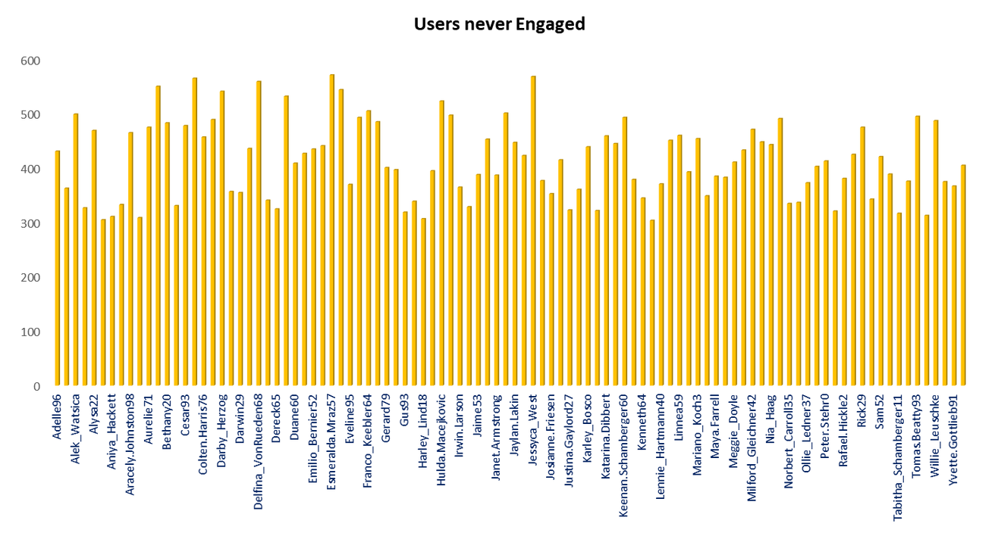
Meta
NewtonSchool
Many Users Never Engage
Several users have never liked any post
These users are completely inactive in engagement
They represent a silent audience on Instagram
*
Many users consume content but never interact, highlighting an engagement gap.
SOCIAL MEDIA | INSTAGRAM
PAGE|10

Slide 11
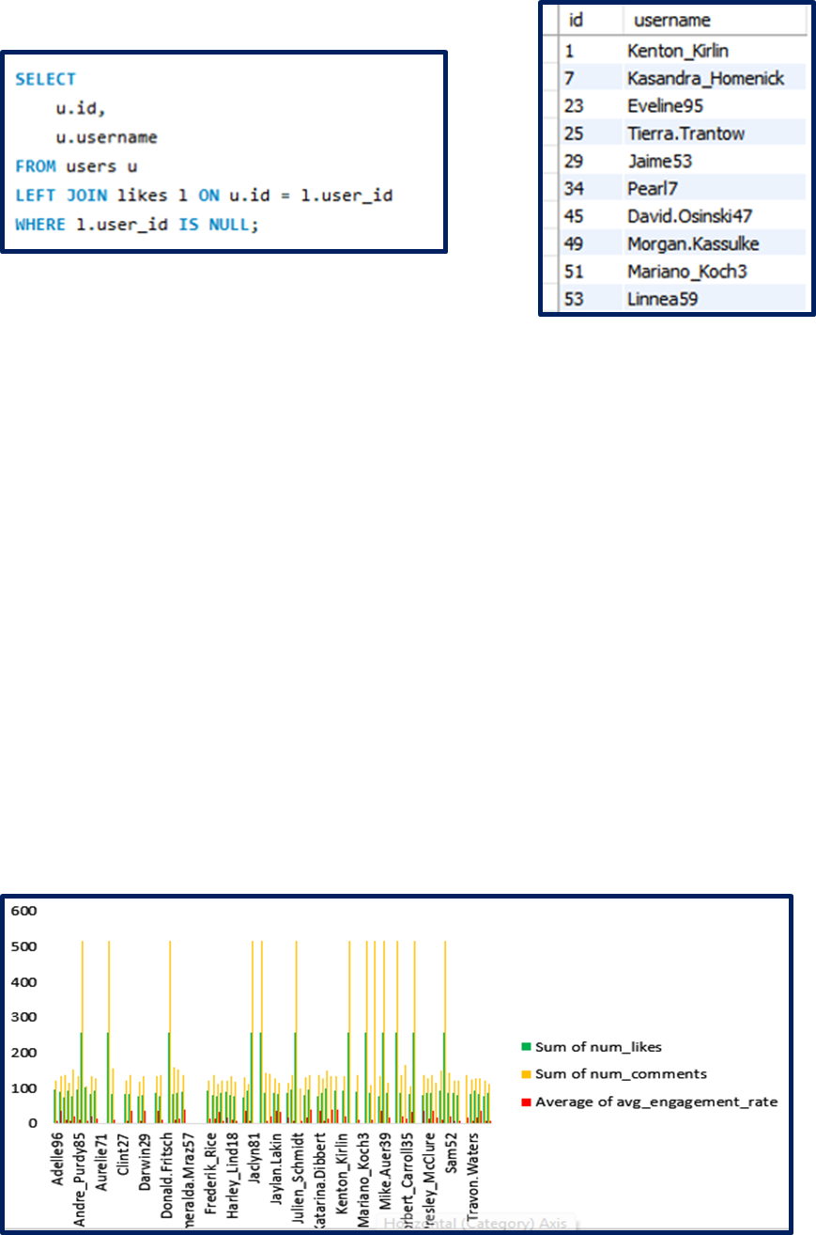
Meta
NewtonSchool
Quality Matters More Than Quantity
Some users receive high engagement even with fewer posts
Engagement varies widely across users
Users respond more to content quality than posting frequency
*
Posting more does not guarantee better engagement; content quality plays a bigger role.
SOCIAL MEDIA | INSTAGRAM
PAGE|11

Slide 12
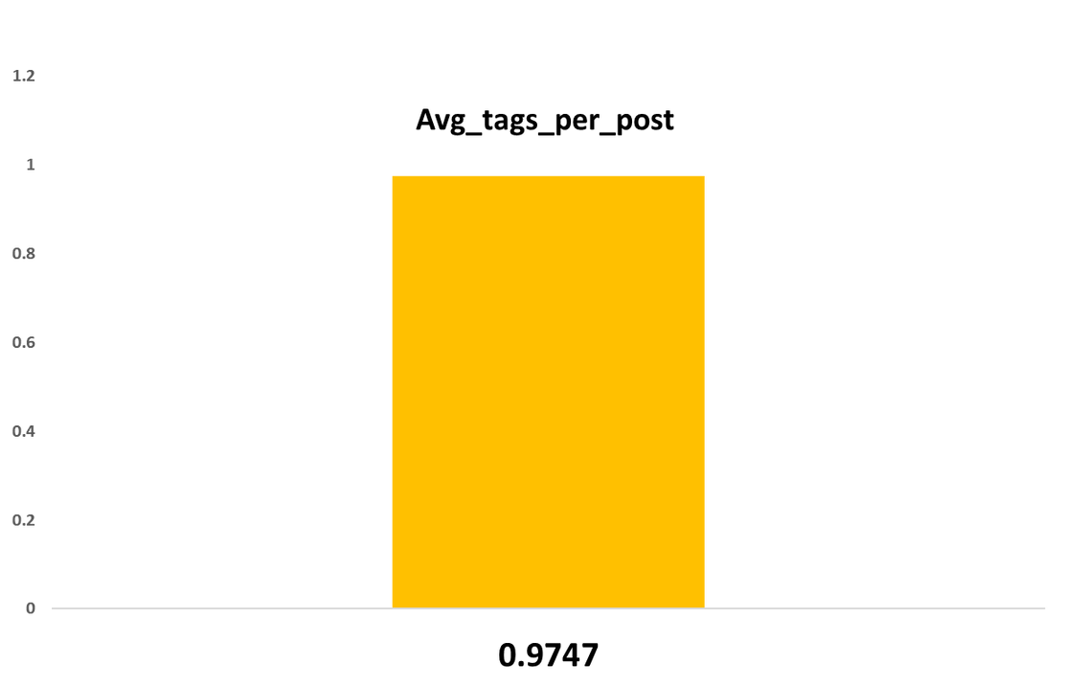
Meta
NewtonSchool
Hashtags Are Underused
On average, posts contain only one hashtag
Low hashtag usage reduces content discoverability
Better hashtag guidance can improve engagement
*
Most posts use very few hashtags, which limits their visibility and reach.
SOCIAL MEDIA | INSTAGRAM
PAGE|12

Slide 13
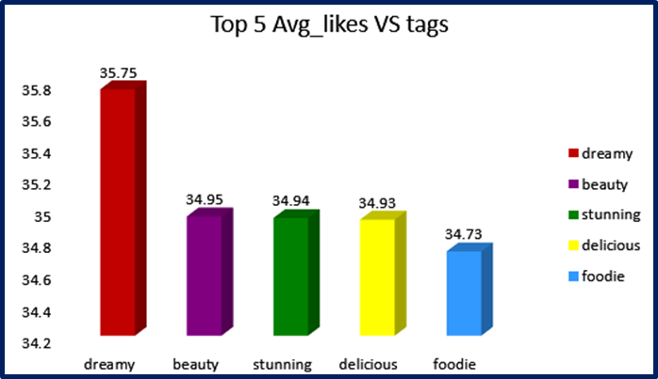
Meta
NewtonSchool
Some Hashtags Perform Better
Niche and descriptive hashtags attract more interaction
Visual and lifestyle-related hashtags perform best
Generic hashtags tend to receive lower engagement
*
Certain hashtags receive much higher engagement, showing that not all hashtags perform equally.
SOCIAL MEDIA | INSTAGRAM
PAGE|13

Slide 14
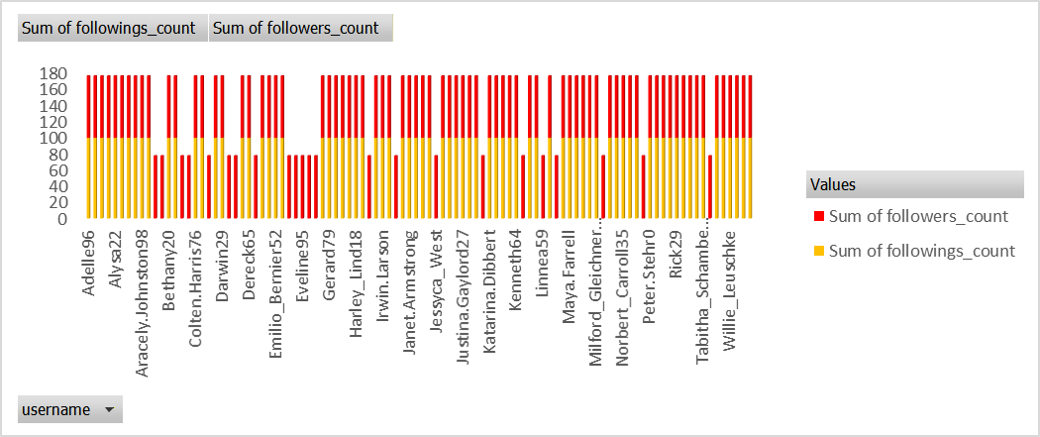
Meta
NewtonSchool
Influencer-Like Users Exist
High follower counts increase content reach
These users can influence engagement patterns
They are valuable for promotions and campaigns
*
Some users have many followers but follow very few accounts, indicating influencer-like behavior.
SOCIAL MEDIA | INSTAGRAM
PAGE|14

Slide 15
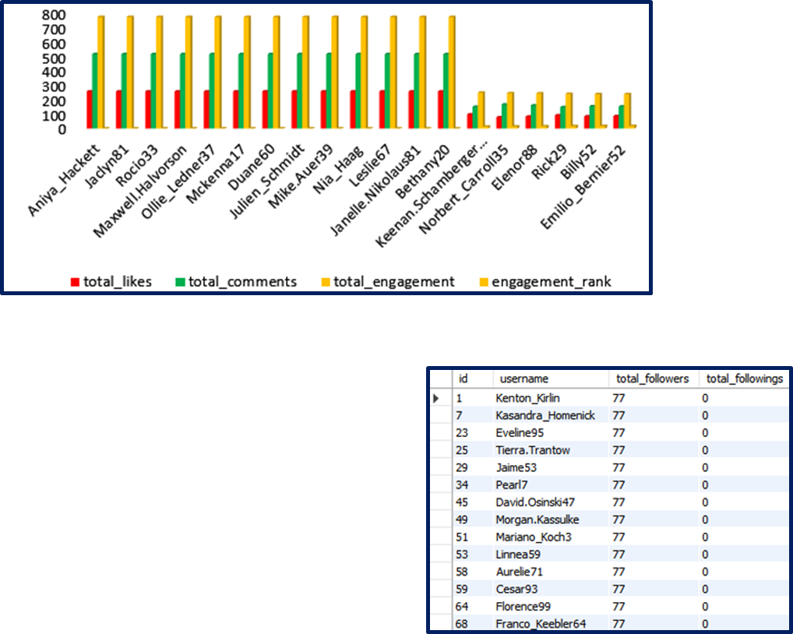
Meta
NewtonSchool
Engagement Varies by Day
Mid-week days show higher likes and comments
Engagement drops towards weekends
Posting on the right day improves visibility
*
User engagement is higher during the middle of the week, showing that timing impacts interaction.
SOCIAL MEDIA | INSTAGRAM
PAGE|15

Slide 16
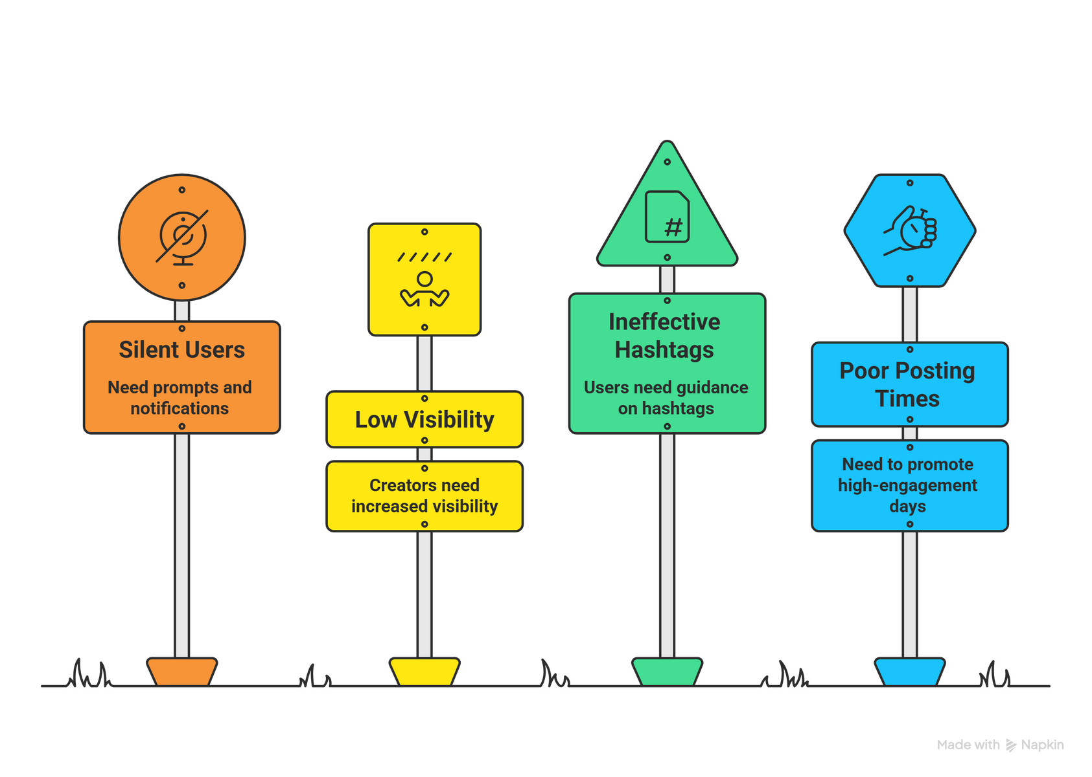
Meta
NewtonSchool
Recommendations
What Instagram Can Do Next
Encourage interaction from silent users using prompts and notifications
Support high-engagement creators by increasing their visibility
Guide users to use effective hashtags while posting
Promote posting during high-engagement days
SOCIAL MEDIA | INSTAGRAM
PAGE|16

Slide 17
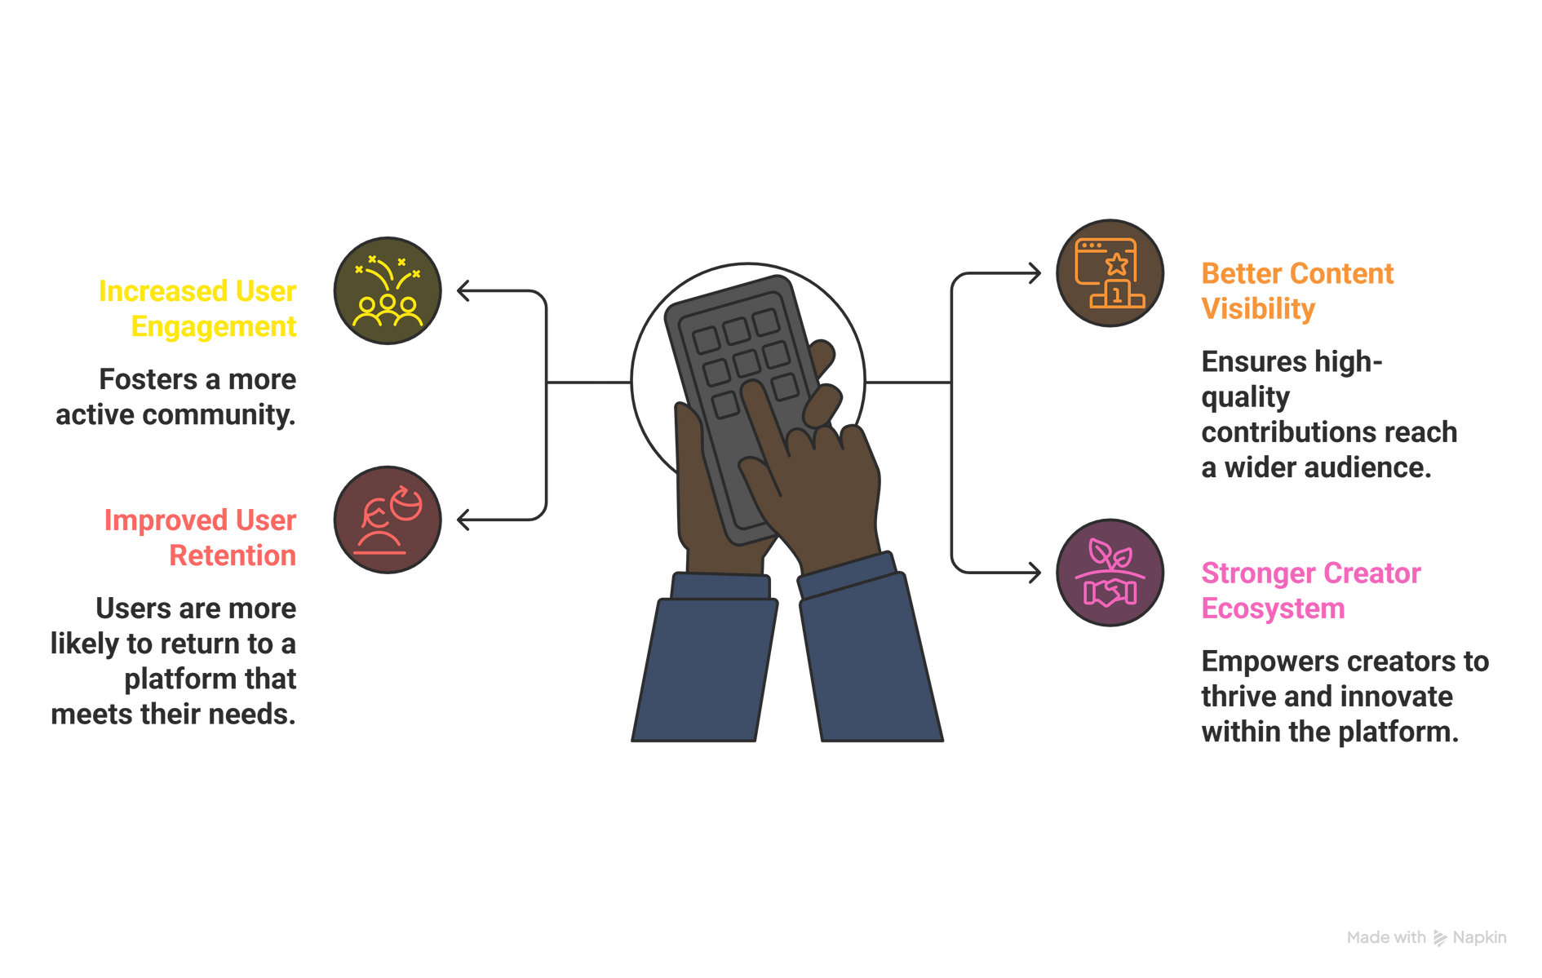
Meta
NewtonSchool
Expected Impact
Increased user engagement
Better content visibility
Improved user retention
Stronger creator ecosystem
SOCIAL MEDIA | INSTAGRAM
PAGE|17

Slide 18
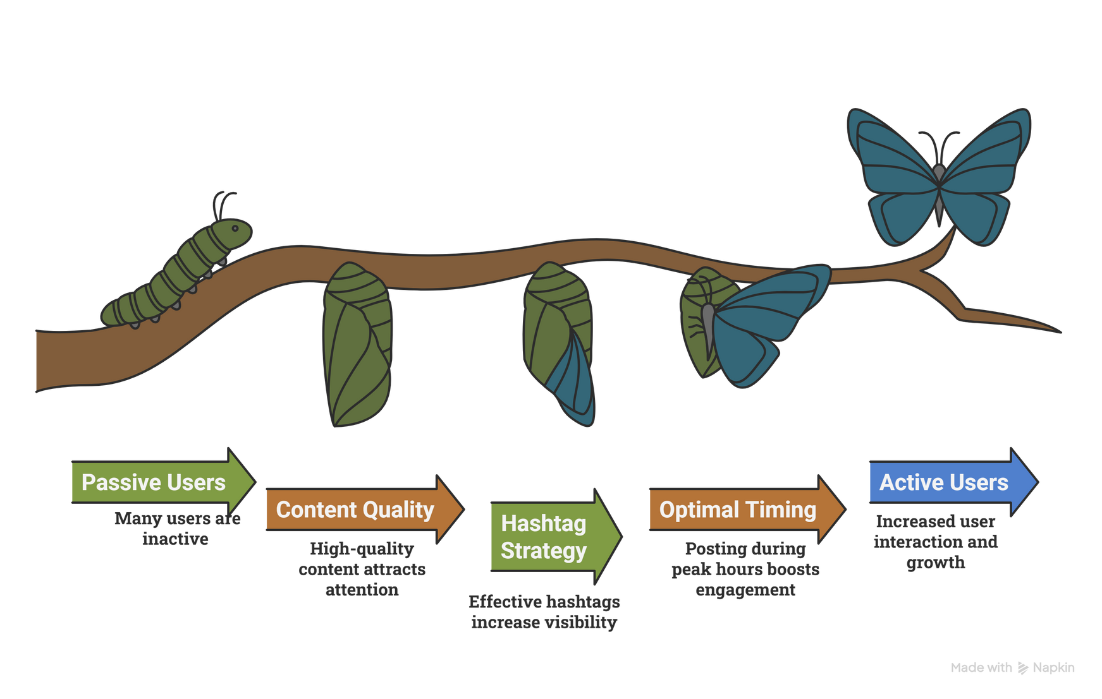
Meta
NewtonSchool
Conclusion
Instagram engagement is driven by a small group of active users
Many users remain passive, creating opportunities for growth
Content quality, hashtags, and timing play a key role in engagement
Data-driven insights can guide smarter marketing decisions
SOCIAL MEDIA | INSTAGRAM
PAGE|18

Slide 19
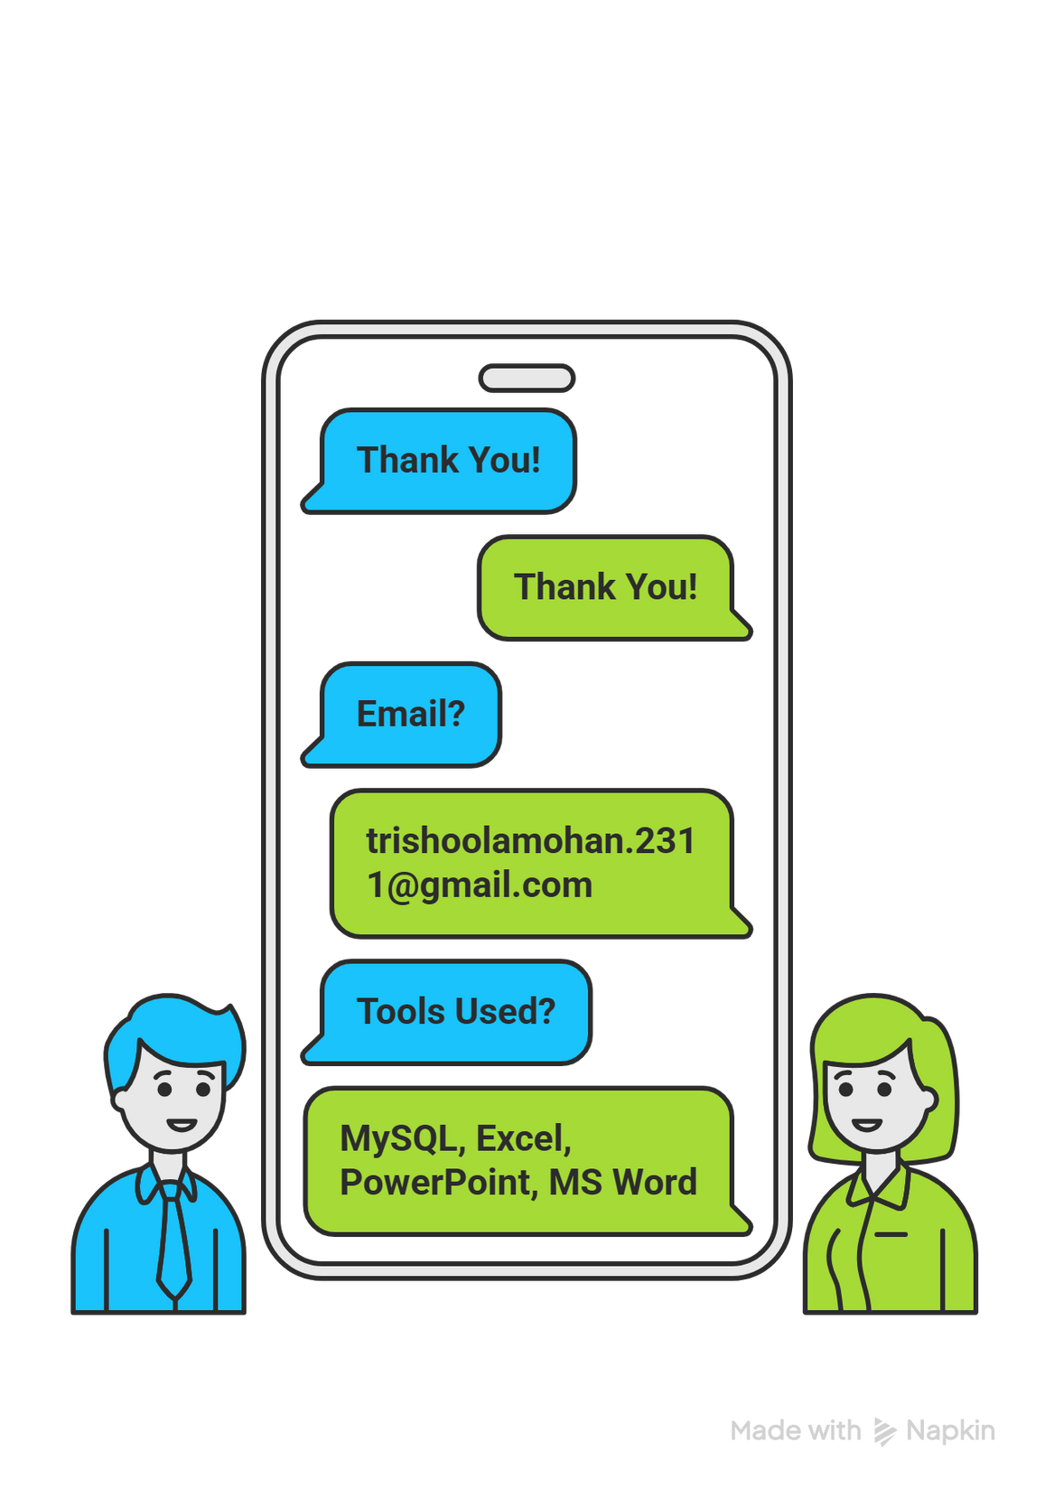
Meta
NewtonSchool
Thank You!
SOCIAL MEDIA | INSTAGRAM
JANUARY 2026

